Slide 1
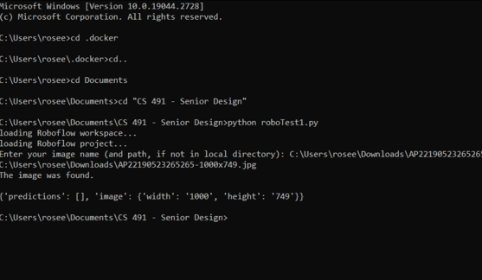
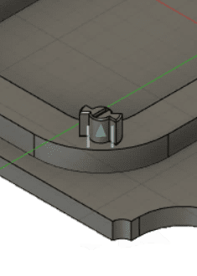
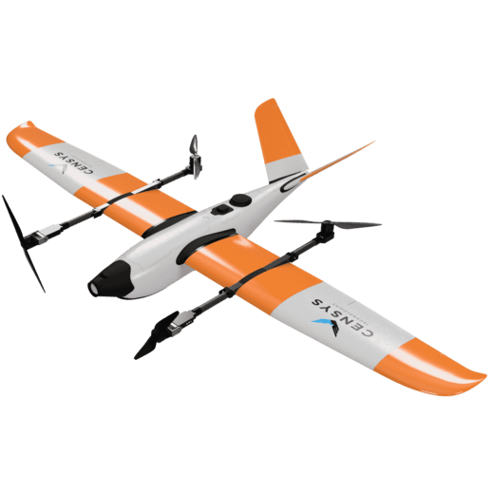
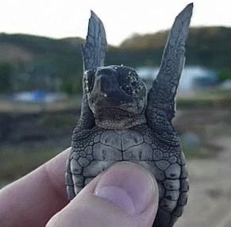
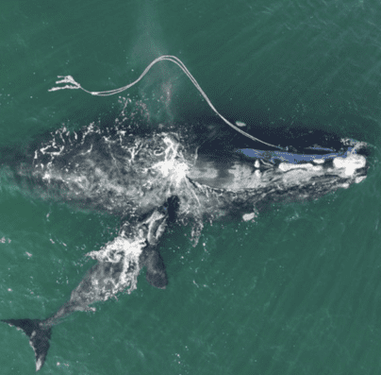
TURTLETECH
Christopher Angland, Laurel Dodson, Parker Brown & RoseEllen Hoke
Notes:
Laurel

Slide 2
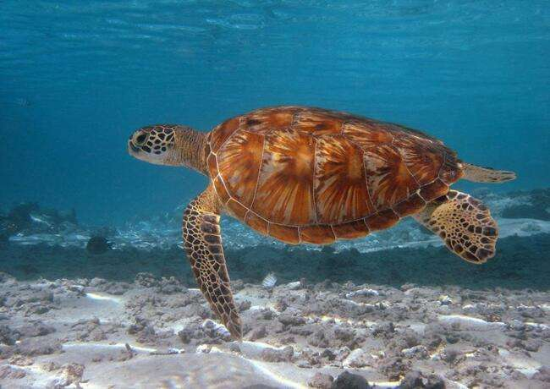
What is the purpose of TurtleTech?
Our goal is to maintain functionality of the neural network software and hardware payload, while creating a framework and instructions to transition the payload between several UAVs to increase the ease of deployment of the system.
Notes:
Laurel

Slide 3
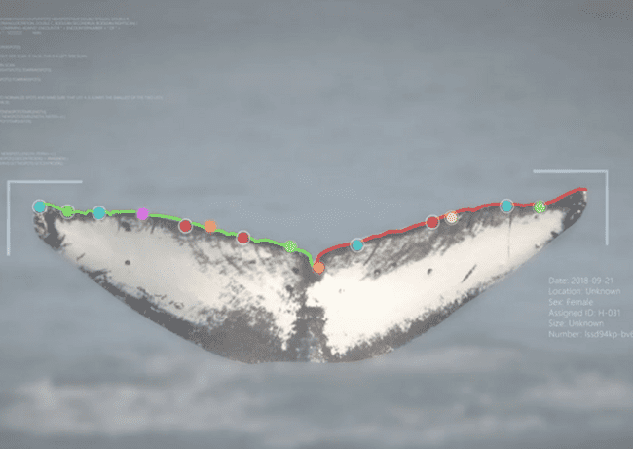
Goals of TurtleTech
Expand
Expand upon the existing TurtleTech project
Refine
Refine current models for better detection
Improve
Improve current payload case
Create
Create documentation for future teams
Notes:
RoseEllen

Slide 4
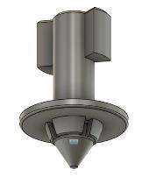
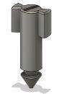
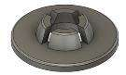
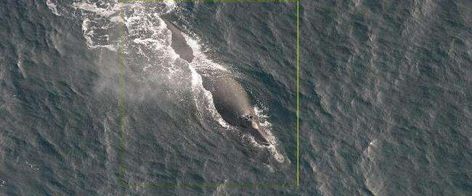
What did we accomplish this semester?
3D modeled and printed a payload casing
3D modeled and printed a battery casing
Built and Trained a new neural network for whale detection
Created documentation for future teams
Notes:
RoseEllen&Chris

Slide 5
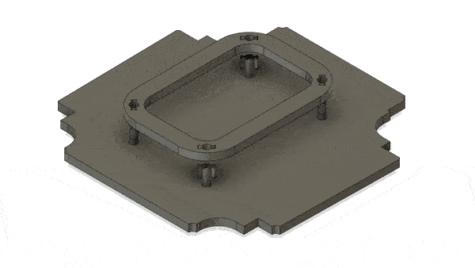
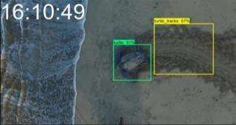
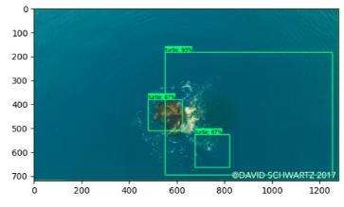
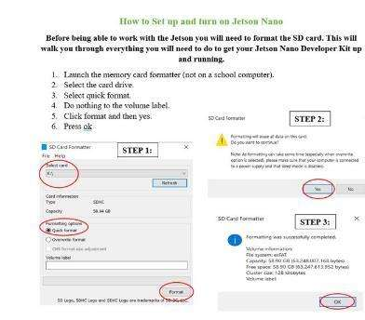
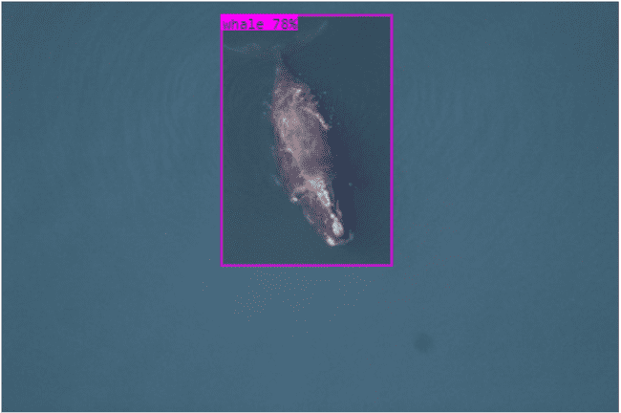
What did we do this year?
Produced a functioning neural network that identifies aerial photos of turtles and whales
Trained a new model for whale detection
Created a hot swappable payload and battery casing
Learned about the neural network's operations during flights
Created tutorial videos and documentation for future teams
Created timestamps for the neural network
Notes:
Chris&RoseEllen

Slide 6
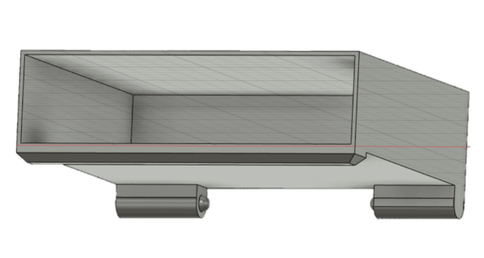
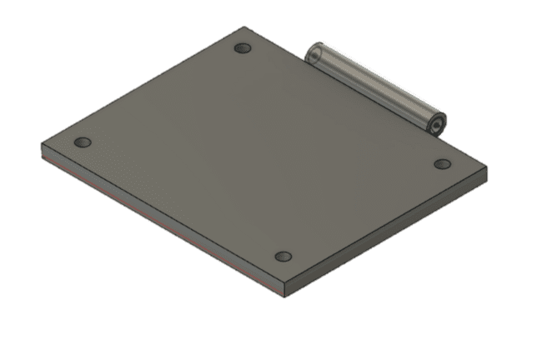
Pivoting Battery Case Holder
Notes:
Chris

Slide 7
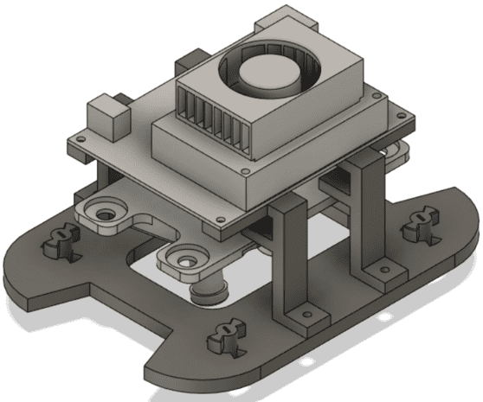
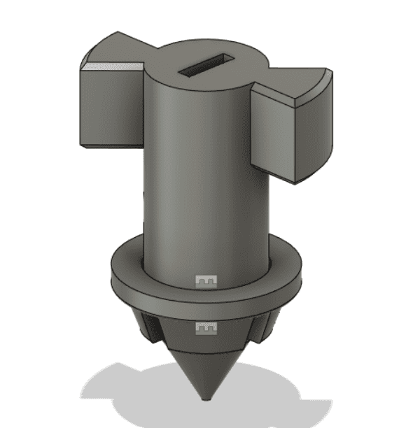
Payload Mounting
Notes:
Parker

Slide 8
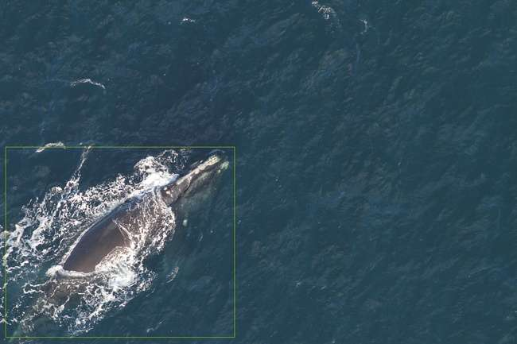
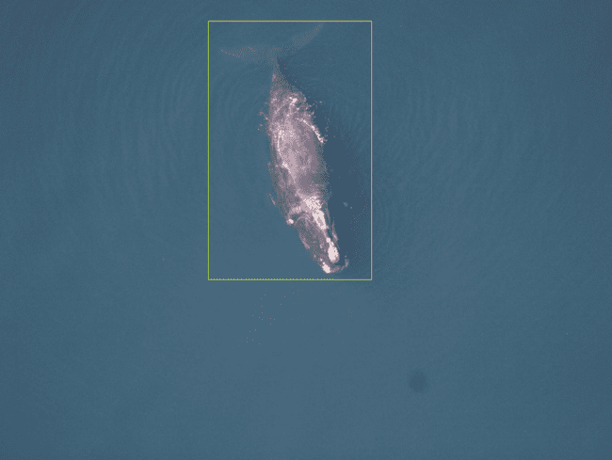
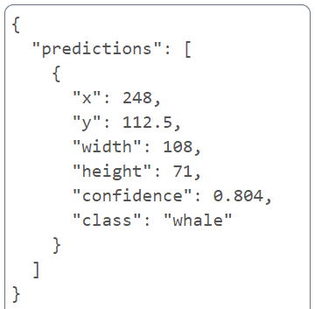
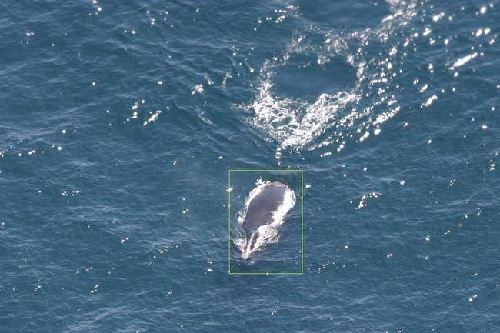
Whale AI Demo
Notes:
Laurel

Slide 9
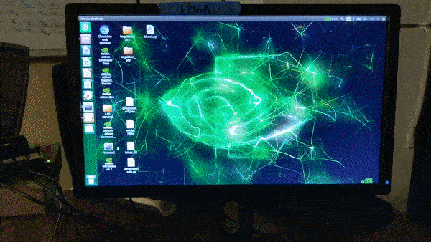
Notes:
Laurel

Slide 10
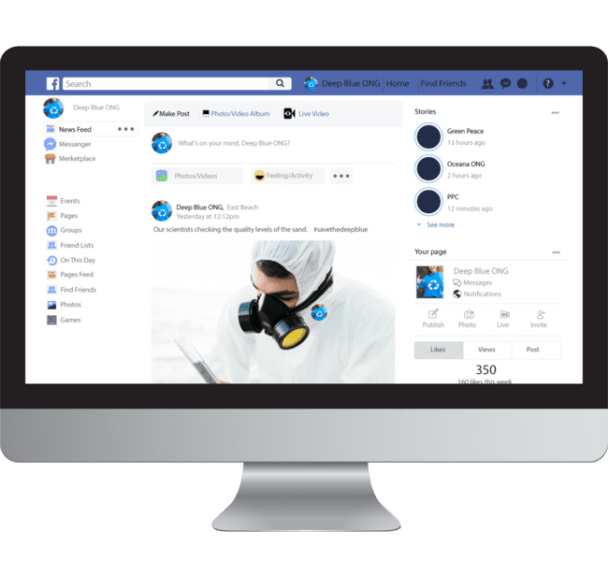
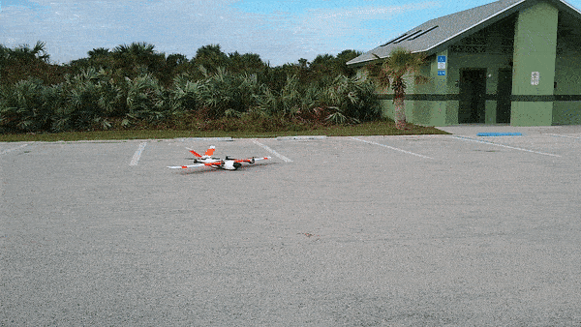
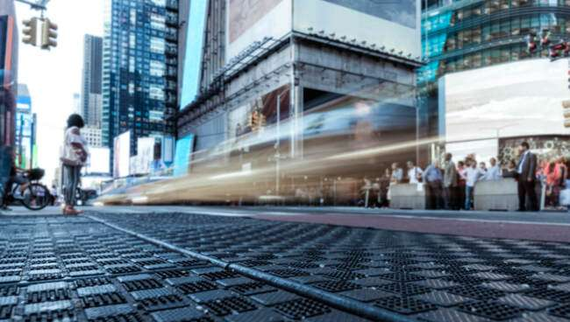
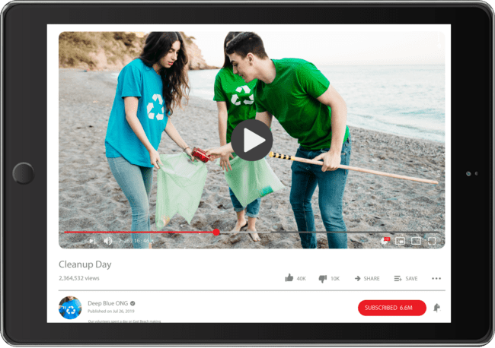
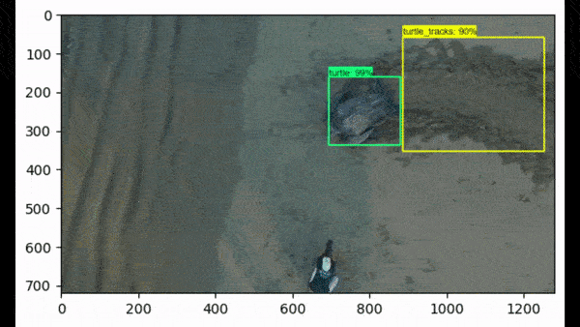
TURTLETECH IN ACTION
10
Notes:
RoseEllen

Slide 11
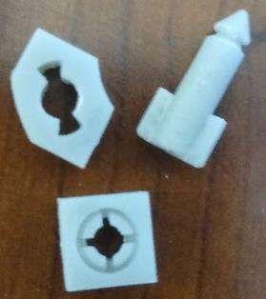
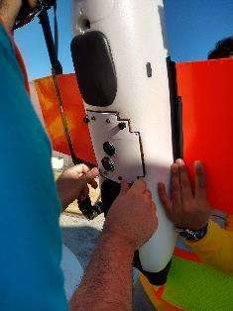
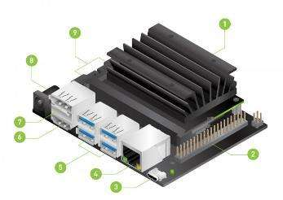
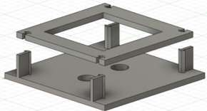
What did we learn?
3D modeling for specifications
How to build, train and test a neural network model
Methods for implementing object ID code
How to start and run the Jetson
Operations during flights
Notes:
RoseEllen

Slide 12


Future of TURTLETECH
Expand upon our current neural network
Build a new neural network using our resources
Test our 3D parts for durability
Notes:
Parker
We have created a good framework for future students to build upon. In the future, students may likely deign to build another neural network , at which point our documentation will be useful.

Slide 13
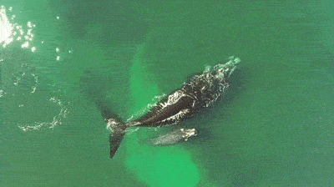
Questions?
Notes:
Parker

